Slide 1
CIS664-Knowledge Discovery and Data Mining
Mining Association Rules
Vasileios Megalooikonomou
Dept. of Computer and Information Sciences
Temple University
(based on notes by Jiawei Han and Micheline Kamber)

Slide 2
Agenda
Association rule mining
Mining single-dimensional Boolean association rules from transactional databases
Mining multilevel association rules from transactional databases
Mining multidimensional association rules from transactional databases and data warehouse
From association mining to correlation analysis
Constraint-based association mining
Summary

Slide 3
Association Mining?
Association rule mining:
Finding frequent patterns, associations, correlations, or causal structures among sets of items or objects in transaction databases, relational databases, and other information repositories.
Applications:
Basket data analysis, cross-marketing, catalog design, loss-leader analysis, clustering, classification, etc.
Examples.
Rule form: “Body → Ηead [support, confidence]”.
buys(x, “diapers”) → buys(x, “beers”) [0.5%, 60%]
major(x, “CS”) ^ takes(x, “DB”) → grade(x, “A”) [1%, 75%]

Slide 4
Association Rules: Basic Concepts
Given: (1) database of transactions, (2) each transaction is a list of items (purchased by a customer in a visit)
Find: all rules that correlate the presence of one set of items with that of another set of items
E.g., 98% of people who purchase tires and auto accessories also get automotive services done
Applications
* ⇒ Maintenance Agreement (What the store should do to boost Maintenance Agreement sales)
Home Electronics ⇒ * (What other products should the store stocks up?)
Attached mailing in direct marketing
Detecting “ping-pong”ing of patients, faulty “collisions”

Slide 5
Interestingness Measures: Support and Confidence
Customer
buys both
Customer
buys diaper
Find all the rules X & Y ⇒ Z with minimum confidence and support
support, s, probability that a transaction contains {X  Y  Z}
confidence, c, conditional probability that a transaction having {X  Y} also contains Z
Customer
buys beer
Let minimum support 50%, and minimum confidence 50%, we have
A ⇒ C (50%, 66.6%)
C ⇒ A (50%, 100%)

Slide 6
Association Rule Mining: A Road Map
Boolean vs. quantitative associations (Based on the types of values handled)
buys(x, “SQLServer”) ^ buys(x, “DMBook”) → buys(x, “DBMiner”) [0.2%, 60%]
age(x, “30..39”) ^ income(x, “42..48K”) → buys(x, “PC”) [1%, 75%]
Single dimension vs. multiple dimensional associations (each distinct predicate of a rule is a dimension)
Single level vs. multiple-level analysis (consider multiple levels of abstraction)
What brands of beers are associated with what brands of diapers?
Extensions
Correlation, causality analysis
Association does not necessarily imply correlation or causality
Maxpatterns (a frequent pattern s.t. any proper subpattern is not frequent) and closed itemsets (if there exist no proper superset c’ of c s.t. any transaction containing c also contains c’)

Slide 7
Agenda
Association rule mining
Mining single-dimensional Boolean association rules from transactional databases
Mining multilevel association rules from transactional databases
Mining multidimensional association rules from transactional databases and data warehouse
From association mining to correlation analysis
Constraint-based association mining
Summary

Slide 8
Mining Association Rules—An Example
Min. support 50%
Min. confidence 50%
For rule A ⇒ C:
support = support({A C}) = 50%
confidence = support({A C})/support({A}) = 66.6%
The Apriori principle:
Any subset of a frequent itemset must be frequent

Slide 9
Mining Frequent Itemsets
Find the frequent itemsets: the sets of items that have minimum support
A subset of a frequent itemset must also be a frequent itemset
i.e., if {AB} is a frequent itemset, both {A} and {B} should be a frequent itemset
Iteratively find frequent itemsets with cardinality from 1 to k (k-itemset)
Use the frequent itemsets to generate association rules.

Slide 10
The Apriori Algorithm: Basic idea
Join Step: C_{k} is generated by joining L_{k-1}with itself
Prune Step: Any (k-1)-itemset that is not frequent cannot be a subset of a frequent k-itemset
Pseudo-code:
C_{k}: Candidate itemset of size k
L_{k} : frequent itemset of size k
L₁ = {frequent items};
for (k = 1; L_{k} !=∅; k++) do begin
C_{k+1} = candidates generated from L_{k};
for each transaction t in database do
increment the count of all candidates in C_{k+1} that are contained in t
L_{k+1} = candidates in C_{k+1} with min_support
end
return ∪_{k} L_{k};

Slide 11
The Apriori Algorithm — Example
Database D
L₁
C₁
Scan D
C₂
C₂
L₂
Scan D
C₃
Scan D
L₃

Slide 12
How to Generate Candidates?
Suppose the items in L_{k-1} are listed in an order
Step 1: self-joining L_{k-1}
insert into C_{k}
select p.item₁, p.item₂, …, p.item_{k-1}, q.item_{k-1}
from L_{k-1} p, L_{k-1} q
where p.item₁=q.item₁, …, p.item_{k-2}=q.item_{k-2}, p.item_{k-1} < q.item_{k-1}
Step 2: pruning
forall itemsets c in C_{k} do
forall (k-1)-subsets s of c do
if (s is not in L_{k-1}) then delete c from C_{k}

Slide 13
How to Count Supports of Candidates?
Why is counting supports of candidates a problem?
The total number of candidates can be huge
Each transaction may contain many candidates
Method:
Candidate itemsets are stored in a hash-tree
Leaf node of hash-tree contains a list of itemsets and counts
Interior node contains a hash table
Subset function: finds all the candidates contained in a transaction

Slide 14
Example of Generating Candidates
L₃={abc, abd, acd, ace, bcd}
Self-joining: L₃*L₃
abcd from abc and abd
acde from acd and ace
Pruning:
acde is removed because ade is not in L₃
C₄={abcd}

Slide 15
Improving Apriori’s Efficiency
Hash-based itemset counting: A k-itemset whose corresponding hashing bucket count is below the threshold cannot be frequent
Transaction reduction: A transaction that does not contain any frequent k-itemset is useless in subsequent scans
Partitioning: Any itemset that is potentially frequent in DB must be frequent in at least one of the partitions of DB
Sampling: mining on a subset of given data, need a lower support threshold + a method to determine the completeness
Dynamic itemset counting: add new candidate itemsets immediately (unlike Apriori) when all of their subsets are estimated to be frequent

Slide 16
Is Apriori Fast Enough? — Performance Bottlenecks
The core of the Apriori algorithm:
Use frequent (k – 1)-itemsets to generate candidate frequent k-itemsets
Use database scan and pattern matching to collect counts for the candidate itemsets
The bottleneck of Apriori: candidate generation
Huge candidate sets:
10⁴ frequent 1-itemset will generate 10⁷ candidate 2-itemsets
To discover a frequent pattern of size 100, e.g., {a₁, a₂, …, a₁₀₀}, one needs to generate 2¹⁰⁰ ≈ 10³⁰ candidates.
Multiple scans of database:
Needs (n +1 ) scans, n is the length of the longest pattern

Slide 17
Mining Frequent Patterns Without Candidate Generation
Compress a large database into a compact, Frequent-Pattern tree (FP-tree) structure
highly condensed, but complete for frequent pattern mining
avoid costly database scans
Develop an efficient, FP-tree-based frequent pattern mining method
A divide-and-conquer methodology: decompose mining tasks into smaller ones
Avoid candidate generation: sub-database test only!

Slide 18
Construct FP-tree from a Transaction DB
TID Items bought (ordered) frequent items
100 {f, a, c, d, g, i, m, p} {f, c, a, m, p}
200 {a, b, c, f, l, m, o} {f, c, a, b, m}
300 {b, f, h, j, o} {f, b}
400 {b, c, k, s, p} {c, b, p}
500 {a, f, c, e, l, p, m, n} {f, c, a, m, p}
min_support = 0.5
{}
Steps:
Scan DB once, find frequent 1-itemset (single item pattern)
Order frequent items in frequency descending order
Scan DB again, construct FP-tree
Header Table
Item frequency head
f 4
c 4
a 3
b 3
m 3
p 3
f:4
c:1
c:3
b:1
b:1
a:3
p:1
m:2
b:1
p:2
m:1

Slide 19
Benefits of the FP-tree Structure
Completeness:
never breaks a long pattern of any transaction
preserves complete information for frequent pattern mining
Compactness
reduce irrelevant information—infrequent items are gone
frequency descending ordering: more frequent items are more likely to be shared
never be larger than the original database (if not count node-links and counts)

Slide 20
Mining Frequent Patterns Using FP-tree
General idea (divide-and-conquer)
Recursively grow frequent pattern path using the FP-tree
Method
For each item, construct its conditional pattern-base, and then its conditional FP-tree
Repeat the process on each newly created conditional FP-tree
Until the resulting FP-tree is empty, or it contains only one path (single path will generate all the combinations of its sub-paths, each of which is a frequent pattern)

Slide 21
Major Steps to Mine FP-tree
Construct conditional pattern base for each node in the FP-tree
Construct conditional FP-tree from each conditional pattern-base
Recursively mine conditional FP-trees and grow frequent patterns obtained so far
If the conditional FP-tree contains a single path, simply enumerate all the patterns

Slide 22
Step 1: From FP-tree to Conditional Pattern Base
Starting at the frequent header table in the FP-tree
Traverse the FP-tree by following the link of each frequent item
Accumulate all of transformed prefix paths of that item to form a conditional pattern base
Header Table
Item frequency head
f 4
c 4
a 3
b 3
m 3
p 3
{}
Conditional pattern bases
item cond. pattern base
c f:3
a fc:3
b fca:1, f:1, c:1
m fca:2, fcab:1
p fcam:2, cb:1
f:4
c:1
c:3
b:1
b:1
a:3
p:1
m:2
b:1
p:2
m:1

Slide 23
Properties of FP-tree for Conditional Pattern Base Construction
Node-link property
For any frequent item a_{i}, all the possible frequent patterns that contain a_{i} can be obtained by following a_{i}'s node-links, starting from a_{i}'s head in the FP-tree header
Prefix path property
To calculate the frequent patterns for a node a_{i} in a path P, only the prefix sub-path of a_{i} in P need to be accumulated, and its frequency count should carry the same count as node a_{i}.

Slide 24
Step 2: Construct Conditional FP-tree
For each pattern-base
Accumulate the count for each item in the base
Construct the FP-tree for the frequent items of the pattern base
{}
m-conditional pattern base:
fca:2, fcab:1
Header Table
Item frequency head
f 4
c 4
a 3
b 3
m 3
p 3
f:4
c:1
{}
All frequent patterns concerning m
m,
fm, cm, am,
fcm, fam, cam,
fcam
c:3
b:1
b:1

a:3
p:1
f:3

m:2
b:1
c:3
p:2
m:1
a:3
m-conditional FP-tree

Slide 25
Mining Frequent Patterns by Creating Conditional Pattern-Bases
Item
Conditional pattern-base
Conditional FP-tree
p
{(fcam:2), (cb:1)}
{(c:3)}|p
m
{(fca:2), (fcab:1)}
{(f:3, c:3, a:3)}|m
b
{(fca:1), (f:1), (c:1)}
Empty
a
{(fc:3)}
{(f:3, c:3)}|a
c
{(f:3)}
{(f:3)}|c
f
Empty
Empty

Slide 26
Step 3: Recursively mine the conditional FP-tree
{}
{}
Cond. pattern base of “am”: (fc:3)
f:3
c:3
f:3
am-conditional FP-tree
c:3
{}
Cond. pattern base of “cm”: (f:3)
a:3
f:3
m-conditional FP-tree
cm-conditional FP-tree
{}
Cond. pattern base of “cam”: (f:3)
f:3
cam-conditional FP-tree

Slide 27
Single FP-tree Path Generation
Suppose an FP-tree T has a single path P
The complete set of frequent pattern of T can be generated by enumeration of all the combinations of the sub-paths of P
{}
All frequent patterns concerning m
m,
fm, cm, am,
fcm, fam, cam,
fcam
f:3

c:3
a:3
m-conditional FP-tree

Slide 28
Principles of Frequent Pattern Growth
Pattern growth property
Let α be a frequent itemset in DB, B be α's conditional pattern base, and β be an itemset in B. Then α ∪ β is a frequent itemset in DB iff β is frequent in B.
“abcdef ” is a frequent pattern, if and only if
“abcde ” is a frequent pattern, and
“f ” is frequent in the set of transactions containing “abcde ”

Slide 29
Why Is Frequent Pattern Growth Fast?
Our performance study shows
FP-growth is an order of magnitude faster than Apriori, and is also faster than tree-projection
Reasoning
No candidate generation, no candidate test
Use compact data structure
Eliminate repeated database scan
Basic operation is counting and FP-tree building

Slide 30
FP-growth vs. Apriori: Scalability With the Support Threshold
Data set T25I20D10K

Slide 31
FP-growth vs. Tree-Projection: Scalability with Support Threshold
Data set T25I20D100K

Slide 32
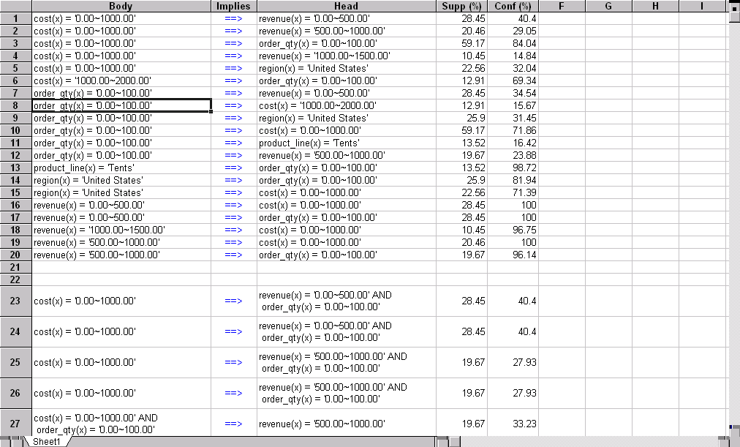
Presentation of Association Rules (Table Form )

Slide 33
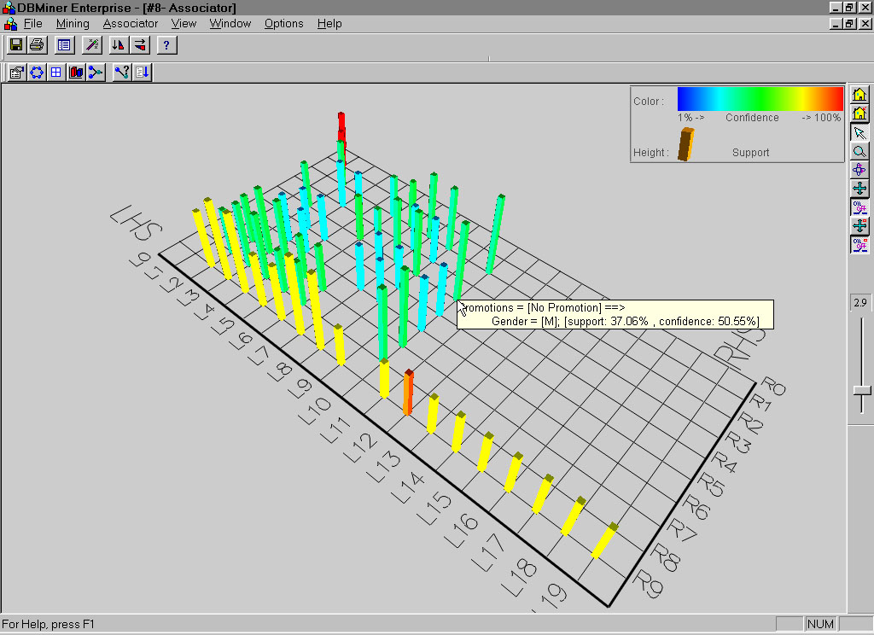
Visualization of Association Rule Using Plane Graph

Slide 34
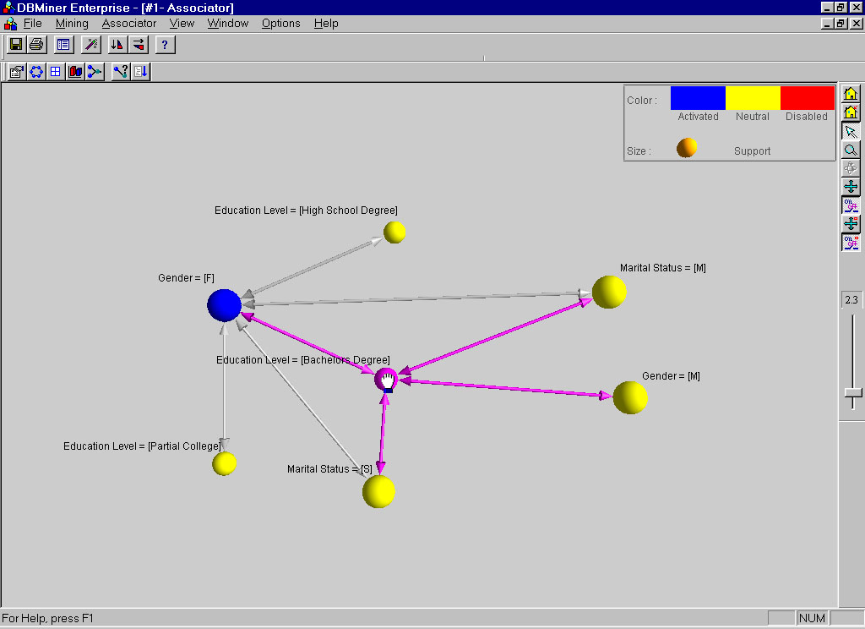
Visualization of Association Rule Using Rule Graph

Slide 35
Iceberg Queries
Icerberg query: Compute aggregates over one or a set of attributes only for those whose aggregate values is above certain threshold
Example:
select P.custID, P.itemID, sum(P.qty)
from purchase P
group by P.custID, P.itemID
having sum(P.qty) >= 10
Compute iceberg queries efficiently by Apriori:
First compute lower dimensions
Then compute higher dimensions only when all the lower ones are above the threshold

Slide 36
Agenda
Association rule mining
Mining single-dimensional Boolean association rules from transactional databases
Mining multilevel association rules from transactional databases
Mining multidimensional association rules from transactional databases and data warehouse
From association mining to correlation analysis
Constraint-based association mining
Summary

Slide 37
Multiple-Level Association Rules
Items often form hierarchies.
Items at the lower level are expected to have lower support.
Rules regarding itemsets at
appropriate levels could be quite useful.
Transaction database can be encoded based on dimensions and levels
We can explore shared multi-level mining
Food
milk
bread
skim
2%
wheat
white
Fraser
Sunset

Slide 38
Mining Multi-Level Associations
A top_down, progressive deepening approach:
First find high-level strong rules:
milk → bread [20%, 60%].
Then find their lower-level “weaker” rules:
2% milk → wheat bread [6%, 50%].
Variations at mining multiple-level association rules.
Level-crossed association rules:
2% milk → Wonder wheat bread
Association rules with multiple, alternative hierarchies:
2% milk → Wonder bread

Slide 39
Multi-level Association: Uniform Support vs. Reduced Support
Uniform Support: the same minimum support for all levels
+ One minimum support threshold. No need to examine itemsets containing any item whose ancestors do not have minimum support.
– Lower level items do not occur as frequently. If support threshold
too high ⇒ miss low level associations
too low ⇒ generate too many high level associations
Reduced Support: reduced minimum support at lower levels
There are 4 search strategies:
Level-by-level independent
Level-cross filtering by k-itemset
Level-cross filtering by single item
Controlled level-cross filtering by single item (level passage threshold)

Slide 40
Uniform Support
Multi-level mining with uniform support
Level 1
min_sup = 5%
Milk
[support = 10%]
Level 2
min_sup = 5%
2% Milk
[support = 6%]
Skim Milk
[support = 4%]
Back

Slide 41
Reduced Support
Multi-level mining with reduced support
Level 1
min_sup = 5%
Milk
[support = 10%]
Level 2
min_sup = 3%
2% Milk
[support = 6%]
Skim Milk
[support = 4%]
Back

Slide 42
Multi-level Association: Redundancy Filtering
Some rules may be redundant due to “ancestor” relationships between items.
Example
milk ⇒ wheat bread [support = 8%, confidence = 70%]
2% milk ⇒ wheat bread [support = 2%, confidence = 72%]
We say the first rule is an ancestor of the second rule.
A rule is redundant if its support is close to the “expected” value, based on the rule’s ancestor.

Slide 43
Multi-Level Mining: Progressive Deepening
A top-down, progressive deepening approach:
First mine high-level frequent items:
milk (15%), bread (10%)
Then mine their lower-level “weaker” frequent itemsets:
2% milk (5%), wheat bread (4%)
Different min_support threshold across multi-levels lead to different algorithms:
If adopting the same min_support across multi-levels
then toss t if any of t’s ancestors is infrequent.
If adopting reduced min_support at lower levels
then examine only those descendents whose ancestor’s support is frequent/non-negligible.

Slide 44
Progressive Refinement of Data Mining Quality
Why progressive refinement?
Mining operator can be expensive or cheap, fine or rough
Trade speed with quality: step-by-step refinement.
Superset coverage property:
Preserve all the positive answers—allow a positive false test but not a false negative test.
Two- or multi-step mining:
First apply rough/cheap operator (superset coverage)
Then apply expensive algorithm on a substantially reduced candidate set (Koperski & Han, SSD’95).

Slide 45
Progressive Refinement Mining of Spatial Association Rules
Hierarchy of spatial relationship:
“g_close_to”: near_by, touch, intersect, contain, etc.
First search for rough relationship and then refine it.
Two-step mining of spatial association:
Step 1: rough spatial computation (as a filter)
Using MBR or R-tree for rough estimation.
Step2: Detailed spatial algorithm (as refinement)
Apply only to those objects which have passed the rough spatial association test (no less than min_support)

Slide 46
Agenda
Association rule mining
Mining single-dimensional Boolean association rules from transactional databases
Mining multilevel association rules from transactional databases
Mining multidimensional association rules from transactional databases and data warehouse
From association mining to correlation analysis
Constraint-based association mining
Summary

Slide 47
Multi-Dimensional Association: Concepts
Single-dimensional rules:
buys(X, “milk”) ⇒ buys(X, “bread”)
Multi-dimensional rules:  2 dimensions or predicates
Inter-dimension association rules (no repeated predicates)
age(X,”19-25”) ∧ occupation(X,“student”) ⇒ buys(X,“coke”)
hybrid-dimension association rules (repeated predicates)
age(X,”19-25”) ∧ buys(X, “popcorn”) ⇒ buys(X, “coke”)
Categorical Attributes
finite number of possible values, no ordering among values
Quantitative Attributes
numeric, implicit ordering among values

Slide 48
Techniques for Mining MD Associations
Search for frequent k-predicate set:
Example: {age, occupation, buys} is a 3-predicate set.
Techniques can be categorized by how age is treated:
1. Using static discretization of quantitative attributes
Quantitative attributes are statically discretized by using predefined concept hierarchies.
2. Quantitative association rules
Quantitative attributes are dynamically discretized into “bins”based on the distribution of the data.
3. Distance-based association rules
This is a dynamic discretization process that considers the distance between data points.

Slide 49
Static Discretization of Quantitative Attributes
Discretized prior to mining using concept hierarchy.
Numeric values are replaced by ranges.
In relational database, finding all frequent k-predicate sets will require k or k+1 table scans.
Data cube is well suited for mining.
The cells of an n-dimensional
cuboid correspond to the
predicate sets.
Mining from data cubes can be much faster.
()
(age)
(income)
(buys)
(age, income)
(age,buys)
(income,buys)
(age,income,buys)

Slide 50
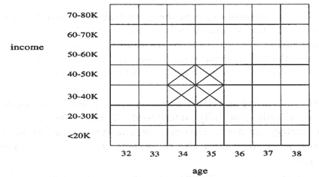
Quantitative Association Rules
Numeric attributes are dynamically discretized
Such that the confidence or compactness of the rules mined is maximized.
2-D quantitative association rules: A_{quan1} ∧ A_{quan2} ⇒ A_{cat}
Cluster “adjacent”
association rules
to form general
rules using a 2-D
grid.
Example:
age(X,”30-34”) ∧ income(X,”24K - 48K”)
⇒ buys(X,”high resolution TV”)

Slide 51
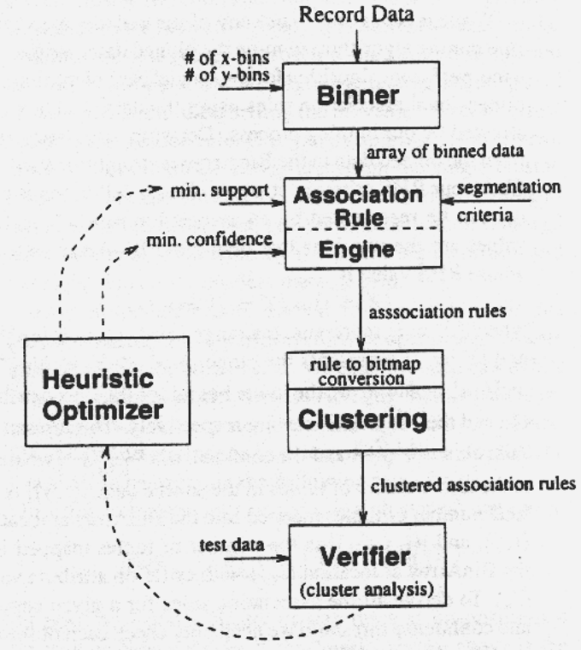
ARCS (Association Rule Clustering System)
How does ARCS work?
1. Binning
2. Find frequent predicate set
3. Clustering
4. Optimize

Slide 52
Limitations of ARCS
Only quantitative attributes on LHS of rules.
Only 2 attributes on LHS. (2D limitation)
An alternative to ARCS
Non-grid-based
equi-depth binning
clustering based on a measure of partial completeness (information lost due to partitioning).
“Mining Quantitative Association Rules in Large Relational Tables” by R. Srikant and R. Agrawal.

Slide 53
Mining Distance-based Association Rules
Binning methods do not capture the semantics of interval data
Distance-based partitioning, more meaningful discretization considering:
density/number of points in an interval
“closeness” of points in an interval

Slide 54
Clusters and Distance Measurements
S[X] is a set of N tuples t₁, t₂, …, t_{N} , projected on the attribute set X
The diameter of S[X]:
dist_{x}:distance metric, e.g. Euclidean distance or Manhattan

Slide 55
Clusters and Distance Measurements
The diameter, d, assesses the density of a cluster C_{X} , where
Finding clusters and distance-based rules
the density threshold, d₀ , replaces the notion of support
modified version of the BIRCH clustering algorithm
Distance between clusters measures degree of association

Slide 56
Agenda
Association rule mining
Mining single-dimensional Boolean association rules from transactional databases
Mining multilevel association rules from transactional databases
Mining multidimensional association rules from transactional databases and data warehouse
From association mining to correlation analysis
Constraint-based association mining
Summary

Slide 57
Interestingness Measures
Objective measures
Two popular measurements:
support; and
confidence
Subjective measures (Silberschatz & Tuzhilin, KDD95)
A rule (pattern) is interesting if
it is unexpected (surprising to the user); and/or
actionable (the user can do something with it)
From association to correlation and causal structure analysis.
Association does not necessarily imply correlation or causal relationships

Slide 58
Criticism to Support and Confidence
Example 1: (Aggarwal & Yu, PODS98)
Among 5000 students
3000 play basketball
3750 eat cereal
2000 both play basket ball and eat cereal
play basketball ⇒ eat cereal [40%, 66.7%] is misleading because the overall percentage of students eating cereal is 75% which is higher than 66.7%.
play basketball ⇒ not eat cereal [20%, 33.3%] is far more accurate, although with lower support and confidence

Slide 59
Criticism to Support and Confidence
Example 2:
X and Y: positively correlated,
X and Z, negatively related
support and confidence of
X=>Z dominates
We need a measure of dependent or correlated events
…=P(B|A)/P(B) is also called the lift of rule A => B

Slide 60
Other Interestingness Measures: Interest
Interest (correlation, lift)
taking both P(A) and P(B) in consideration
P(A^B)=P(B)*P(A), if A and B are independent events
A and B negatively correlated, if the value is less than 1; otherwise A and B positively correlated

Slide 61
Agenda
Association rule mining
Mining single-dimensional Boolean association rules from transactional databases
Mining multilevel association rules from transactional databases
Mining multidimensional association rules from transactional databases and data warehouse
From association mining to correlation analysis
Constraint-based association mining
Summary

Slide 62
Constraint-Based Mining
Interactive, exploratory mining giga-bytes of data?
Could it be real? — Making good use of constraints!
What kinds of constraints can be used in mining?
Knowledge type constraint: classification, association, etc.
Data constraint: SQL-like queries
Find product pairs sold together in Vancouver in Dec.’98.
Dimension/level constraints:
in relevance to region, price, brand, customer category.
Rule constraints
On the form of the rules to be mined (e.g., # of predicates, etc)
small sales (price < $10) triggers big sales (sum > $200).
Interestingness constraints:
Thresholds on measures of interestingness
strong rules (min_support ≥ 3%, min_confidence ≥ 60%).

Slide 63
Rule Constraints in Association Mining
Two kind of rule constraints:
Rule form constraints: meta-rule guided mining.
P(x, y) ^ Q(x, w) → takes(x, “database systems”).
Rule (content) constraint: constraint-based query optimization (Ng, et al., SIGMOD’98).
sum(LHS) < 100 ^ min(LHS) > 20 ^ count(LHS) > 3 ^ sum(RHS) > 1000
1-variable vs. 2-variable constraints (Lakshmanan, et al. SIGMOD’99):
1-var: A constraint confining only one side (L/R) of the rule, e.g., as shown above.
2-var: A constraint confining both sides (L and R).
sum(LHS) < min(RHS) ^ max(RHS) < 5* sum(LHS)

Slide 64
Constraint-Based Association Query
Database: (1) trans (TID, Itemset ), (2) itemInfo (Item, Type, Price)
A constrained assoc. query (CAQ) is in the form of {(S1, S2 )|C },
where C is a set of constraints on S1, S2 including frequency constraint
A classification of (single-variable) constraints:
Class constraint: S ⊂ A. e.g. S ⊂ Item
Domain constraint:
Sθ v, θ ∈ { =, ≠, <, ≤, >, ≥ }. e.g. S.Price < 100
vθ S, θ is ∈ or ∉. e.g. snacks ∉ S.Type
Vθ S, or Sθ V, θ ∈ { ⊆, ⊂, ⊄, =, ≠ }
e.g. {snacks, sodas } ⊆ S.Type
Aggregation constraint: agg(S) θ v, where agg is in {min, max, sum, count, avg}, and θ ∈ { =, ≠, <, ≤, >, ≥ }.
e.g. count(S1.Type) = 1 , avg(S2.Price) < 100

Slide 65
Constrained Association Query Optimization Problem
Given a CAQ = { (S1, S2) | C }, the algorithm should be :
sound: It only finds frequent sets that satisfy the given constraints C
complete: All frequent sets satisfy the given constraints C are found
A naïve solution:
Apply Apriori for finding all frequent sets, and then to test them for constraint satisfaction one by one.
Other approach:
Comprehensive analysis of the properties of constraints and try to push them as deeply as possible inside the frequent set computation.

Slide 66
Anti-monotone and Monotone Constraints
A constraint C_{a} is anti-monotone iff. for any pattern S not satisfying C_{a}, none of the super-patterns of S can satisfy C_{a}
A constraint C_{m} is monotone iff. for any pattern S satisfying C_{m}, every super-pattern of S also satisfies it

Slide 67
Succinct Constraint
A subset of item I_{s} is a succinct set, if it can be expressed as σ_{p}(I) for some selection predicate p, where σ is a selection operator
SP⊆2^{I} is a succinct power set, if there is a fixed number of succinct set I₁, …, I_{k} ⊆I, s.t. SP can be expressed in terms of the strict power sets of I₁, …, I_{k} using union and minus
A constraint C_{s} is succinct provided SAT_{Cs}(I) is a succinct power set

Slide 68
Convertible Constraint
Suppose all items in patterns are listed in a total order R
A constraint C is convertible anti-monotone iff a pattern S satisfying the constraint implies that each suffix of S w.r.t. R also satisfies C
A constraint C is convertible monotone iff a pattern S satisfying the constraint implies that each pattern of which S is a suffix w.r.t. R also satisfies C

Slide 69
Relationships Among Categories of Constraints
Succinctness
Anti-monotonicity
Monotonicity
Convertible constraints
Inconvertible constraints

Slide 70
Property of Constraints: Anti-Monotone
Anti-monotonicity: If a set S violates the constraint, any superset of S violates the constraint.
Examples:
sum(S.Price) ≤ v is anti-monotone
sum(S.Price) ≥ v is not anti-monotone
sum(S.Price) = v is partly anti-monotone
Application:
Push “sum(S.price) ≤ 1000” deeply into iterative frequent set computation.

Slide 71
Characterization of Anti-Monotonicity Constraints
S θ v, θ ∈ { =, ≤, ≥ }
v ∈ S
S ⊇ V
S ⊆ V
S = V
min(S) ≤ v
min(S) ≥ v
min(S) = v
max(S) ≤ v
max(S) ≥ v
max(S) = v
count(S) ≤ v
count(S) ≥ v
count(S) = v
sum(S) ≤ v
sum(S) ≥ v
sum(S) = v
avg(S) θ v, θ ∈ { =, ≤, ≥ }
(frequent constraint)
yes
no
no
yes
partly
no
yes
partly
yes
no
partly
yes
no
partly
yes
no
partly
convertible
(yes)

Slide 72
Example of Convertible Constraints: Avg(S) θ V
Let R be the value descending order over the set of items
E.g. I={9, 8, 6, 4, 3, 1}
Avg(S) ≥ v is convertible monotone w.r.t. R
If S is a suffix of S₁, avg(S₁) ≥ avg(S)
{8, 4, 3} is a suffix of {9, 8, 4, 3}
avg({9, 8, 4, 3})=6 ≥ avg({8, 4, 3})=5
If S satisfies avg(S) ≥v, so does S₁
{8, 4, 3} satisfies constraint avg(S) ≥ 4, so does {9, 8, 4, 3}

Slide 73
Property of Constraints: Succinctness
Succinctness:
For any set S1 and S2 satisfying C, S1 ∪ S2 satisfies C
Given A1 is the sets of size 1 satisfying C, then any set S satisfying C are based on A1 , i.e., it contains a subset belongs to A1 ,
Example :
sum(S.Price ) ≥ v is not succinct
min(S.Price ) ≤ v is succinct
Optimization:
If C is succinct, then C is pre-counting prunable. The satisfaction of the constraint alone is not affected by the iterative support counting.

Slide 74
Characterization of Constraints by Succinctness
S θ v, θ ∈ { =, ≤, ≥ }
v ∈ S
S ⊇V
S ⊆ V
S = V
min(S) ≤ v
min(S) ≥ v
min(S) = v
max(S) ≤ v
max(S) ≥ v
max(S) = v
count(S) ≤ v
count(S) ≥ v
count(S) = v
sum(S) ≤ v
sum(S) ≥ v
sum(S) = v
avg(S) θ v, θ ∈ { =, ≤, ≥ }
(frequent constraint)
Yes
yes
yes
yes
yes
yes
yes
yes
yes
yes
yes
weakly
weakly
weakly
no
no
no
no
(no)

Slide 75
Agenda
Association rule mining
Mining single-dimensional Boolean association rules from transactional databases
Mining multilevel association rules from transactional databases
Mining multidimensional association rules from transactional databases and data warehouse
From association mining to correlation analysis
Constraint-based association mining
Summary

Slide 76
Summary
Association rule mining
probably the most significant contribution from the database community in KDD
large number of papers
Many interesting issues have been explored
An interesting research direction
Association analysis in other types of data: spatial data, multimedia data, time series data, etc.

